Slide 1
Exploratory Data Analysis (EDA) Project
Sales - MySQL Analysis

Slide 2
Project Overview
Objective:
Analyze customer behavior, sales trends, and product performance.
Datasets:
- Category
- Order_Details.csv
- Orders
- Users

Slide 3
Database Design
Schema Definition:
Category: CategoryID, CategoryName, Description
Order_Details: OrderDetailID, OrderID, ProductID, Quantity, UnitPrice, Total
Orders: OrderID, UserID, OrderDate, OrderStatus
Users: UserID, UserName, Email, RegistrationDate, Location
Relationships:
- Foreign keys link Orders to Users and Order_Details.

Slide 4
Data Exploration - Key Questions
Key Questions:
1. Sales Performance:
Total sales by category and product.
2. Customer Insights:
Active locations and top buyers.
3. Operational Insights:
Order status breakdown and trends.

Slide 5
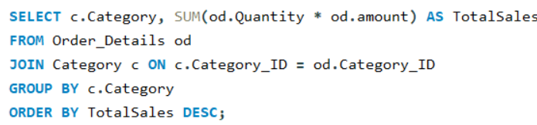
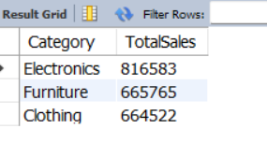
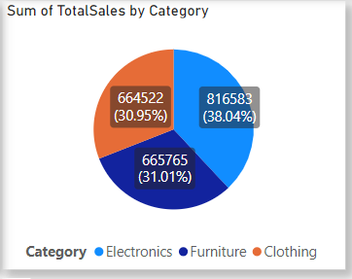
SQL Queries
1. Total Sales by Category:
Result:

Slide 6
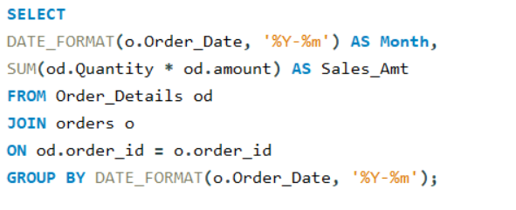
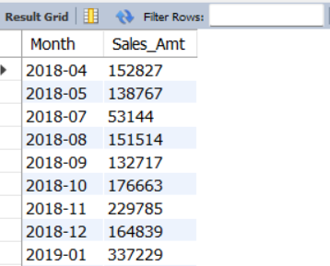
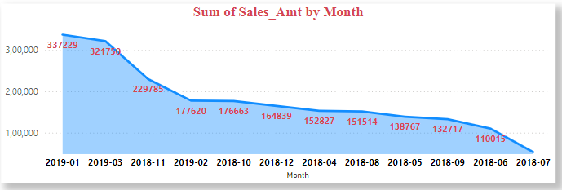
2. Monthly Sales Trends:
Result:

Slide 7
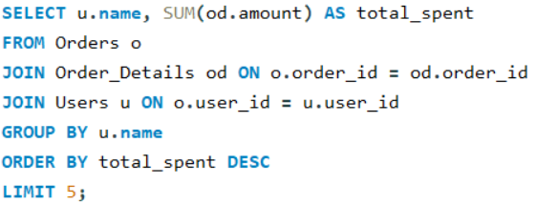
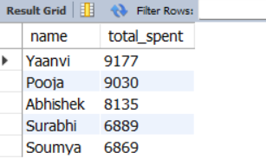
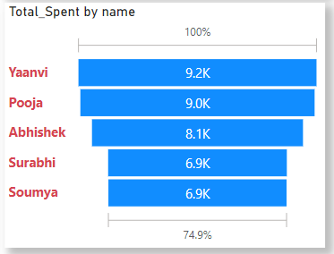
3. Find the top 5 users who have spent the most amount of money.
Result:

Slide 8
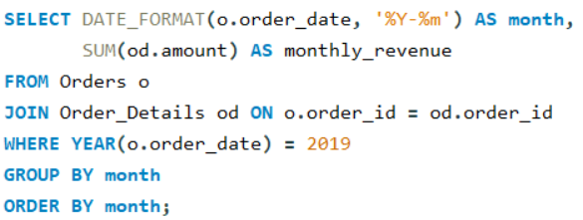
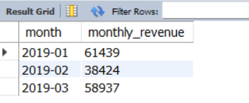
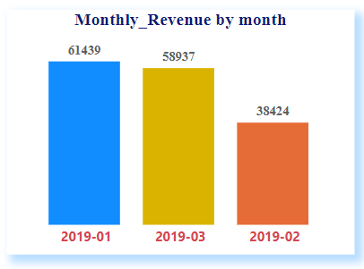
4. Calculate the monthly revenue for the year 2019.
Result:

Slide 9
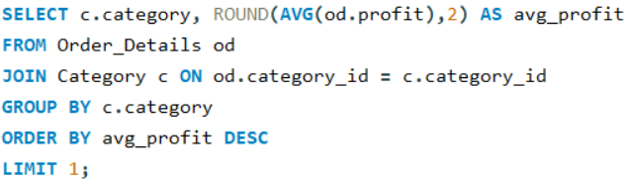
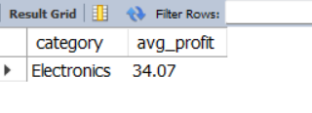
5. Identify the category with the highest average profit per order.
Result:

Slide 10
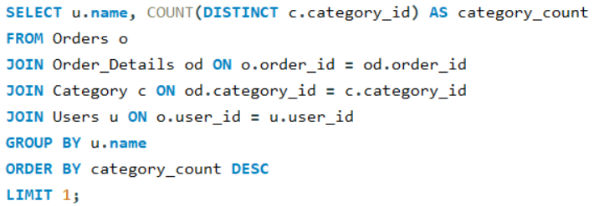
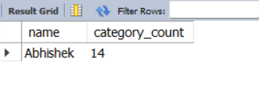
6. Find the user who has placed orders in the most number of different categories.
Result:

Slide 11
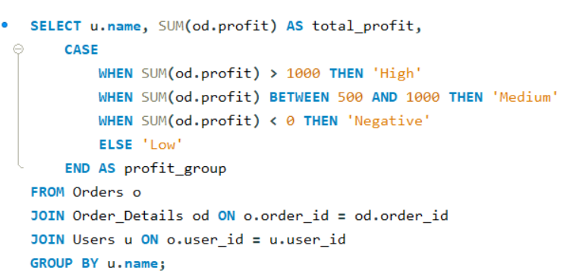
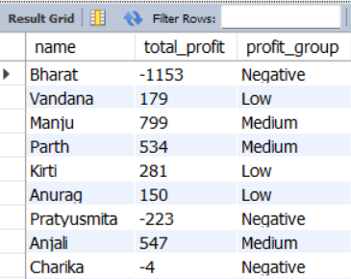
7. Calculate the total profit for each user and categorize them into 'High', 'Medium', and 'Low' profit groups.
Result
Result:

Slide 12
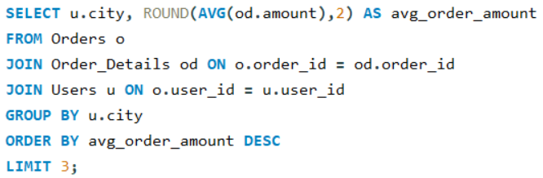
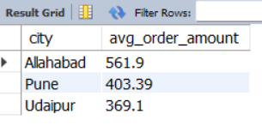
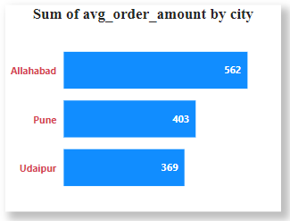
8. Find the top 3 cities with the highest average order amount.
Result:

Slide 13
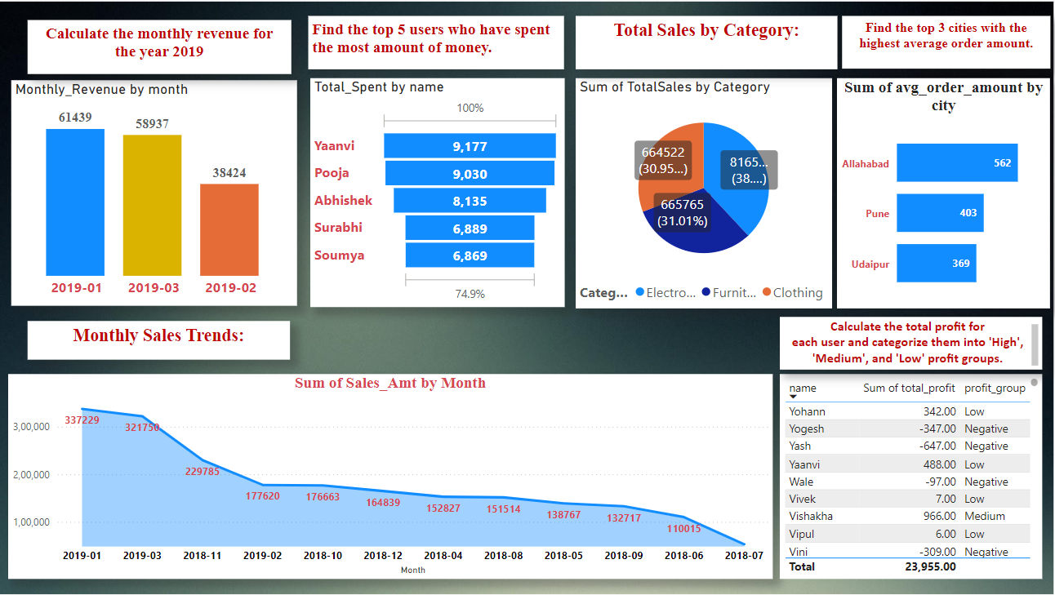
Visualization using Power BI

Slide 14

Insights
Total Sales by Category: Identifies which categories generate the most revenue.
Monthly Sales Trends: Shows sales trends over time, highlighting any seasonal patterns.
Top 5 Users by Spending: Recognizes the top 5 users who have spent the most money.
Monthly Revenue for 2019: Analyzes financial performance month by month for 2019.
Category with Highest Average Profit per Order: Identifies the most profitable category.
Monthly Order Count for 2019: Understands order volume trends throughout 2019.
User with Most Diverse Orders: Recognizes users with diverse purchasing habits.
Total Profit by User and Profit Group: Segments users based on their profitability.
Top 3 Cities by Average Order Amount: Identifies the most lucrative markets.

